Slide 1

There is / There are
9
The Perfect House

Slide 2
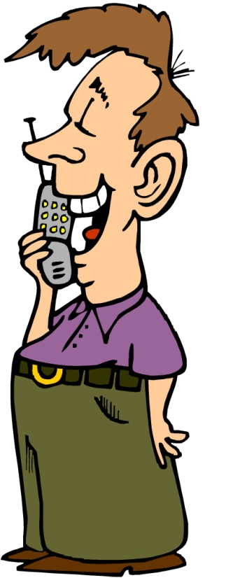

Our New House
Sweety, I have the perfect house for you. You are going to love it.
Oh, that’s great!
Tell me all about it.

Slide 3
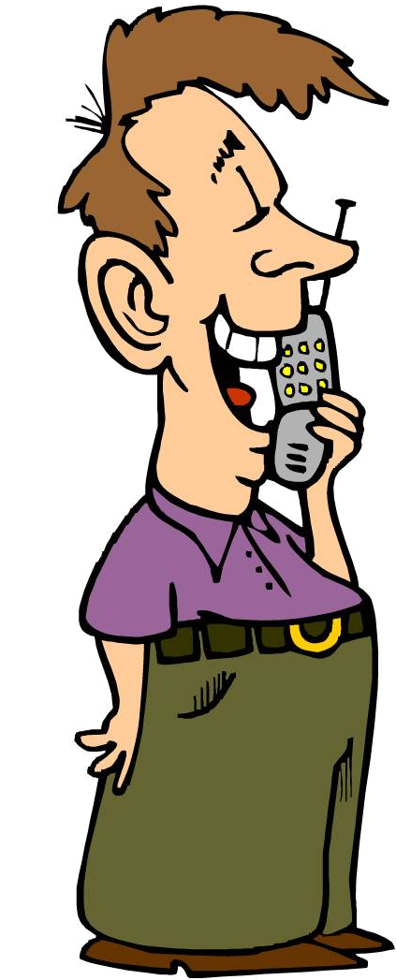
Our New House
There is a big yard.
There’s air conditioning.
There are good schools around

Slide 4


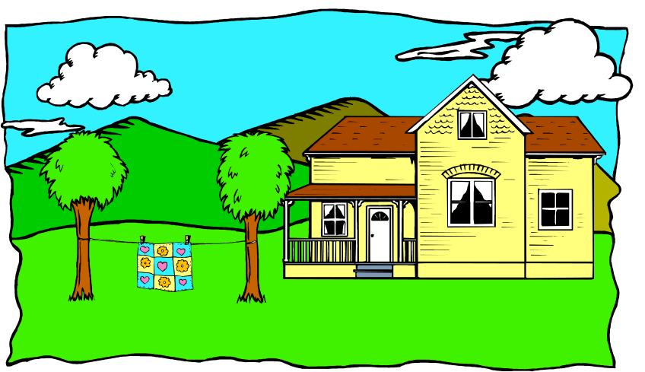
Present Singular
Use there is or there’s to state facts about a person or thing.
There is a big backyard.
There is air conditioning.

Slide 5

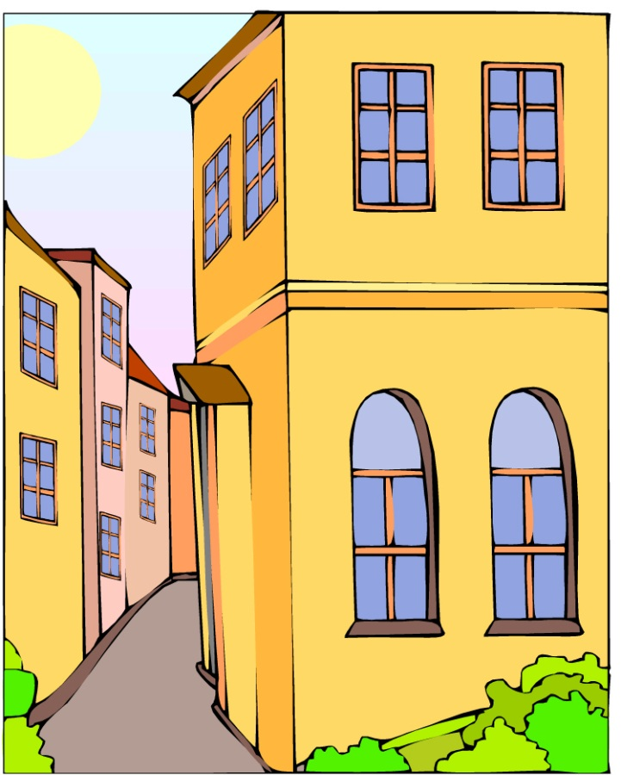

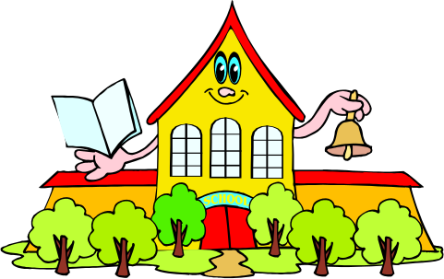
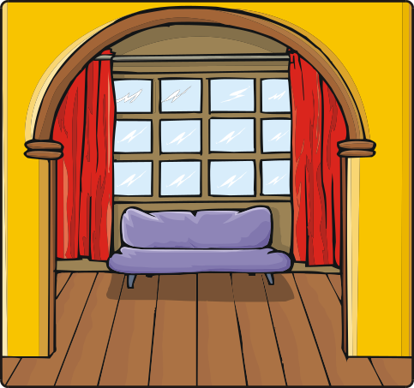
Present Plural
Use there are if the noun is plural.
There are a lot of windows.
There are good schools around.

Slide 6

The Perfect House
No, there isn’t a fireplace, but there’s a big space for my flat screen TV.
No, there aren’t any trees, but there’s a big driveway for my car.
There’s an extra bedroom for my mother!
… but there’s a basketball court.
Hmmm . . . Great.
Are there trees in the yard?
Is there a fireplace?
There isn’t a swimming pool,…
Is there a swimming pool?

Slide 7
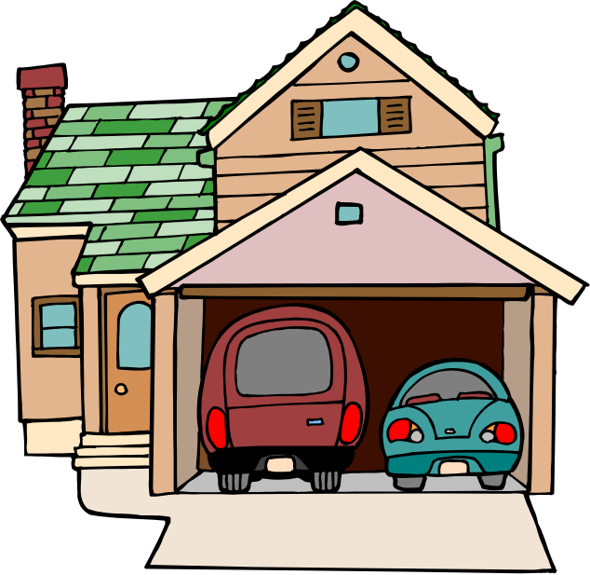
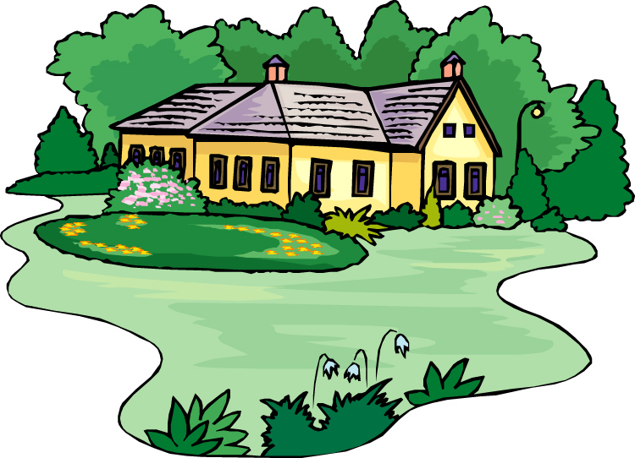


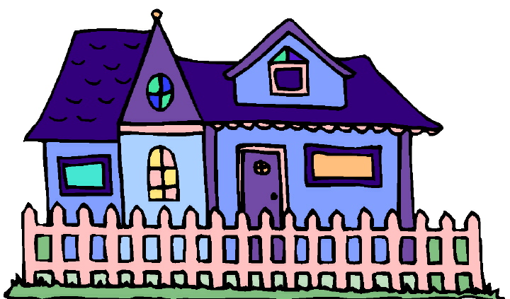
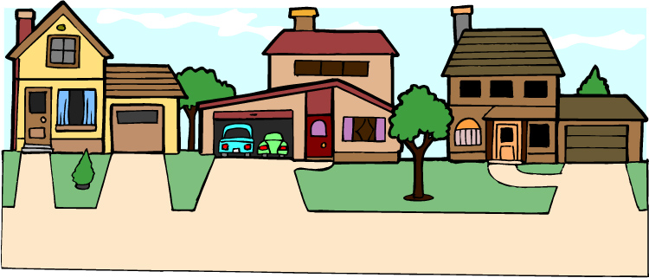
Negative
To state a negative fact, you can use there isn’t a / an or there aren’t any.
present singular
There isn’t a garage.
present plural
There aren’t any trees in the yard.
present singular
There isn’t a fence.
present plural
There aren’t a lot of neighbors.
Notes:
Reword:
To state a negative fact, you can use there isn't a/an (4 words bold italics) or there aren't any (3 words bold italics

Slide 8
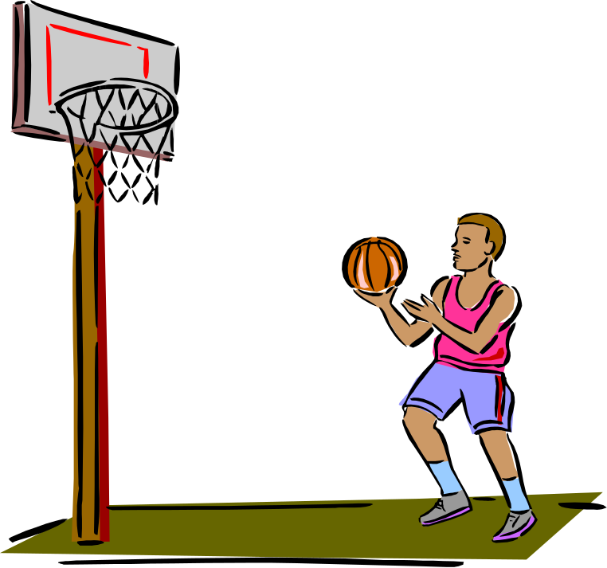
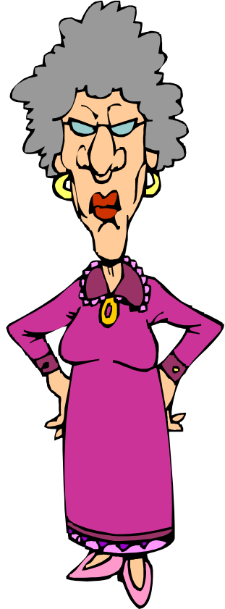
Contractions
Use there’s in speaking and informal writing.
There’s a basketball court.
There’s an extra bedroom for my mother.

Slide 9

Practice 1
Look at the information about Mrs. Chan’s class. Make sentences using there is, there are and information about this class.
Mrs. Chan’s History Class
 | Quiz | Students | Homework | Readings
This Week | 0 | 18 | very little | many
Example:
This week, there isn’t a quiz.
This week, there are 18 students.
This week, there is very little homework.
This week, there are many readings.

Slide 10
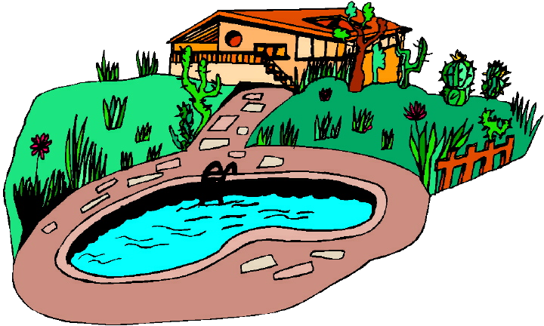
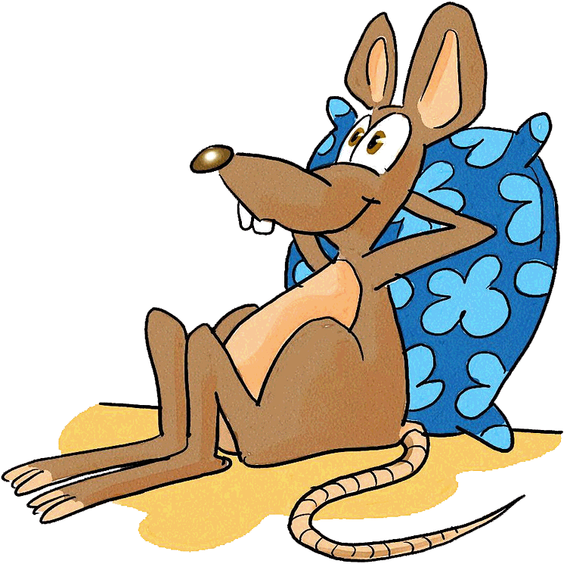
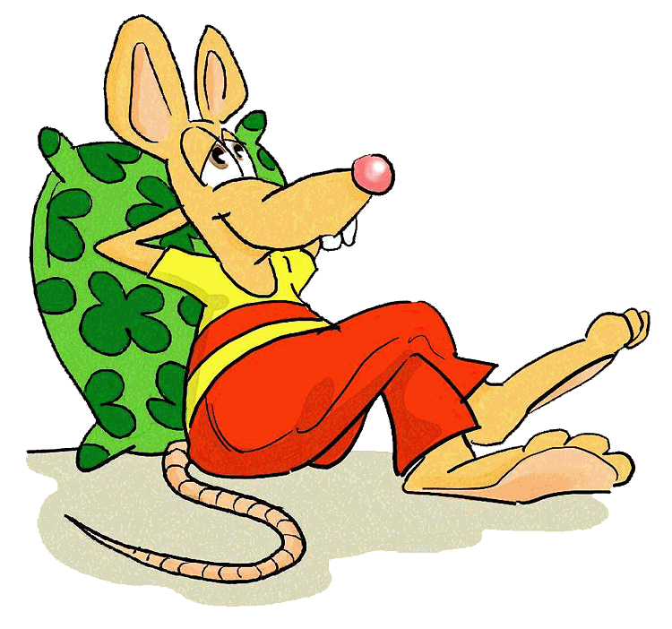
Questions
Put is, or are before there to make a question.
Is there a swimming pool?
Are there mice in the house?

Slide 11
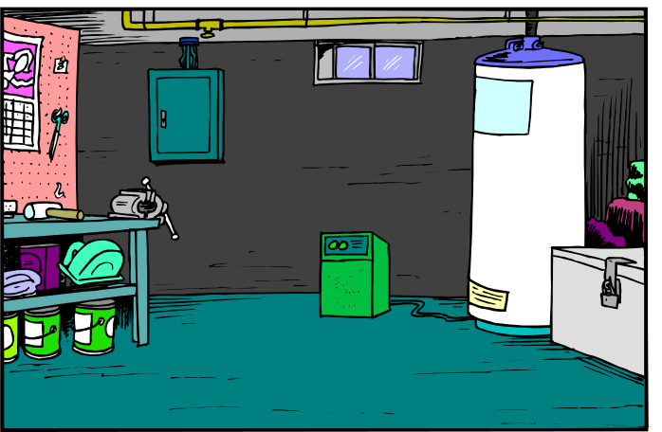
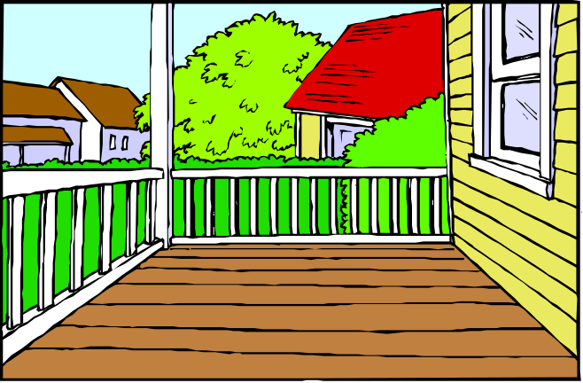
Short Answers
Use there in questions and short answers.
Are there any problems in the basement?
No, there aren’t.
Is there a porch?
Yes, there is.

Slide 12
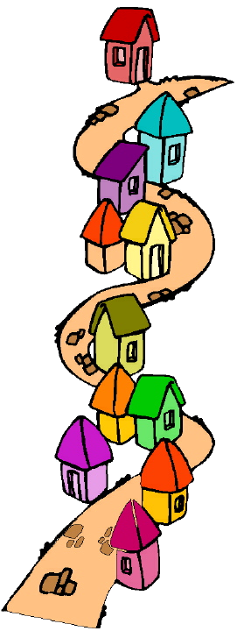

Practice 2
Ask a partner questions about his or her neighborhood. Use is there, are there and short answers.
Are there lots of houses in your neighborhood?
Example:
lots of houses
No, there aren’t.
a good school
many children
big avenues
restaurants
problems
cafés
parks
trees

Slide 13
Questions with there is/are
How many tables are there in the dining room?
There is one (table).
How many chairs are there in the kitchen?
There are five chairs.
How many beds are there in the living room?
There aren’t any (beds).

Slide 14
Practice

Slide 15


Slide 16
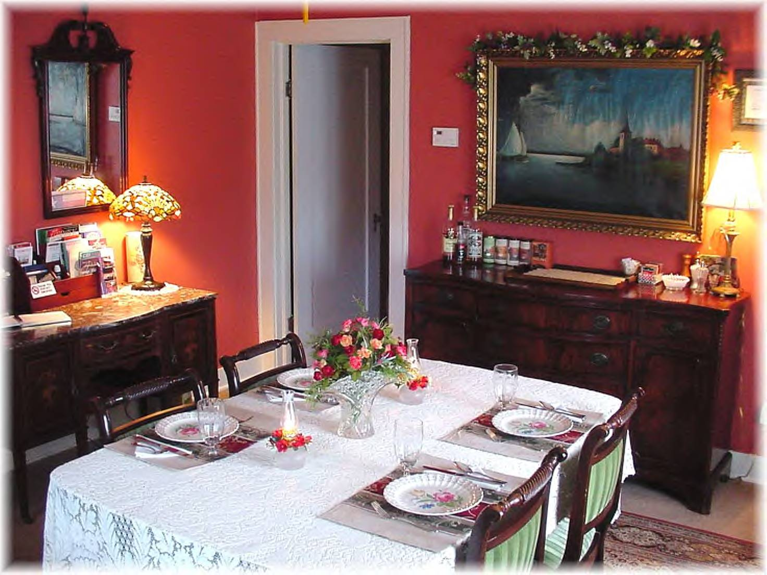

Slide 17
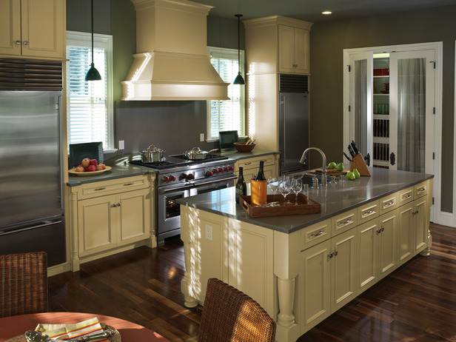

Slide 18
